Slide 1

AIDEX Assistant
An AI assistant that learns how each person likes to be helped, and measures it
Palden Gurung · S00391340 AIDEX Lab Chatbot Presentation · Australian Catholic University
Notes:
Hi Professor. In this presentation I'll walk you through my project for the AIDEX Lab, the AIDEX Assistant. It's a chatbot that learns how each person likes to be helped, and it measures whether that actually matters. I'll start with a real-life example, then the research problem, what's new about my approach, what I've built so far, and where it goes next.

Slide 2


Why we love a café that remembers us
A REAL-LIFE EXAMPLE
"The usual? Oat flat white, extra hot."
Knows the recipe for 40 different drinks
Remembers how you like it
Every café knows the menu
You never repeat yourself, so you keep coming back
Useful, but it doesn't make the visit feel personal
INTENT CALIBRATION
DOMAIN KNOWLEDGE
So why do most chatbots remember the menu, but forget how you like your coffee?
Notes:
Think about your favourite café. The barista sees you walk in and says, 'The usual? Oat flat white, extra hot.' You didn't have to say a word. That's why you keep going back. Every café knows the menu, the recipes for forty different drinks, but that's not what makes it feel personal. What makes it personal is remembering how you like it. So here's the question behind my project: why do most chatbots remember the menu, but forget how you like your coffee?

Slide 3



Meet Priya, a first-year IT student
A REAL-LIFE SCENARIO
Visit 1
Visit 2
Visit 3
"I'm an IT student. Please keep answers short, with bullet points."
Asks about internships. Gets a long essay written for nobody in particular
Repeats her preferences again, and the bot still doesn't stick to them
Gets a good answer
Has to repeat herself
Gives up and closes the tab
Most chatbots treat every visit as the first, and forget how Priya likes to be helped.
Notes:
Now let's bring that to the lab. Meet Priya, a first-year IT student looking at the AIDEX Lab website. On her first visit she tells the chatbot she's an IT student and wants short answers with bullet points, and she gets a good answer. The next day she comes back to ask about internships, and gets a long generic essay. So she repeats herself. On her third visit the same thing happens, and she gives up. This is the everyday problem: most chatbots treat every visit as the first, and they don't remember how a person likes to be helped.

Slide 4




What problem are we solving?
RESEARCH PROBLEM
Why it matters
Repeated effort
Users keep restating who they are and what they want
Research question
How can an AI assistant learn and use each person's preferences in a way that is transparent, safe and measurable?
Hidden memory
When assistants do remember, users rarely see or control what was kept
No evidence
Few systems measure whether a memory actually helped
Notes:
So the research problem is this: how can an AI assistant learn and use each person's preferences in a way that is transparent, safe and measurable? It matters for three reasons. Users waste effort repeating themselves. When assistants do remember things, the memory is usually hidden, so people can't see or correct it. And there's very little evidence about which memories actually help, because most systems don't measure it.

Slide 5
Preferences matter more than facts
WHAT THE LAB'S RESEARCH FOUND
3.4 : 1
In self-improving AI systems, rules about how a person wants help were reused 3.4 times more often than domain facts.
In practice: "use bullet points" helps with almost every question. "I study IT" only matters for some.
Parameswaran, Hussain & Hossain (2026). The Human Layer of Agentic AI Memory. In AI-Driven Mathematics Education, Springer, pp. 35–52.
Notes:
The lab's own chapter, The Human Layer of Agentic AI Memory, gives us a clue. It looked at what self-improving AI systems actually learn in production, and found that rules about how a person wants to be helped were reused about 3.4 times more often than domain facts. In practice, a preference like 'use bullet points' helps with almost every question, while a fact like 'I study IT' only matters for some. So the most valuable memory is about the person, not the subject. My project takes that finding and builds it into a working assistant.

Slide 6
Where current chatbots fall short
HOW THIS DIFFERS FROM EXISTING APPROACHES
 | Typical FAQ chatbot | Typical assistant memory | AIDEX Assistant
Answers grounded in verified data | ~ | ~ | ✓
Learns how each person likes answers | ✗ | ✓ | ✓
Separates preferences from facts | ✗ | ✗ | ✓
Measures which memories were actually used | ✗ | ✗ | ✓
Switches off unhelpful memories by itself | ✗ | ~ | ✓
User can see, edit and delete memories | ✗ | ✓ | ✓
Runs on a local model, no outside company | ✗ | ✗ | ✓
✓ yes ~ partly or varies ✗ usually not. A general comparison of common approaches, not a benchmark of specific products.
Notes:
Here's how my approach compares with what's out there. A typical FAQ chatbot answers questions but doesn't learn anything about you. Assistants with memory do learn preferences, but they usually mix preferences and facts together, don't measure which memories were actually used, and run on an outside company's servers. The AIDEX Assistant is designed to do all of these together: it separates preferences from facts, measures their use, switches off memories that aren't helping, lets the user stay in control, and runs on a local model.

Slide 7




What this work contributes
RESEARCH CONTRIBUTIONS AND NOVELTY
1
Two-layer memory
2
Measured reuse
Every memory is labelled as intent calibration or domain knowledge, the split from the paper
The model reports which memories shaped each answer, so reuse is counted, not assumed
3
Self-correcting loop
4
Transparent and private
Corrections, feedback and disuse switch memories off automatically, with a reason
Opt-in, editable memory, consent and withdrawal, and a local AI model
Notes:
This work makes four contributions. First, a two-layer memory: every memory is labelled as either intent calibration, meaning how you like to be helped, or domain knowledge, meaning facts about you. That's the exact split from the paper. Second, measured reuse: the model reports which memories shaped each answer, so the system counts real usage rather than assuming it. Third, a self-correcting loop: if a memory keeps getting corrected or is never used, it switches itself off and records why. And fourth, it's transparent and private by design: memory is opt-in and editable, research needs consent, and the AI model runs locally.

Slide 8



What gets remembered?
PRACTICAL EXAMPLES
User says…
Saved as
Intent calibration
"From now on, keep answers under 50 words."
Intent
How the person likes to be helped, including what they mean when they correct it
"Please always use bullet points."
Intent
"No, I meant the publications, not the people."
Intent
Domain knowledge
"I'm a Bachelor of IT student."
Domain
Facts about the person, useful for some questions
"I'm interested in agentic AI."
Domain
"Who leads the lab?"
Not saved
Not saved
Ordinary questions, and sensitive details like health, are never stored
"I'm a patient with a medical condition."
Not saved
Notes:
Here are some practical examples of how the assistant sorts what people say. 'Keep answers under 50 words' and 'always use bullet points' are intent calibration, they're about how the person likes to be helped. Even a correction like 'No, I meant the publications' teaches it what the person means. 'I'm a Bachelor of IT student' and 'I'm interested in agentic AI' are domain knowledge, facts about the person. And some things are never saved: an ordinary question like 'Who leads the lab?', or anything sensitive, like health information.

Slide 9





System architecture
HOW IT WORKS
Chat website
Python backend (FastAPI)
SQLite database
Users, memories, logs
HTML, CSS, JavaScript
1 Safety check (guardrails)
2 Learn from the message
ChromaDB search
Themes, papers, people
3 Recall personal memories
4 Search lab knowledge
Ollama · Gemma 2
AI model on this computer
5 Ask the local AI model
Admin dashboard
Lab data files
Reuse ratio, CSV export
6 Record which memories helped
From the lab website
Notes:
Here's the architecture. The user chats on a simple website. Every message goes to a Python backend built with FastAPI, which runs six steps. First, a safety check. Second, it learns anything new from the message, like a preference. Third, it recalls the person's relevant memories from the SQLite database. Fourth, it searches the lab's knowledge, the themes, publications and people, using ChromaDB. Fifth, it asks a local AI model, Gemma 2 running in Ollama, to write the answer. And sixth, it records which memories were actually used. All of that feeds the admin dashboard.

Slide 10







How memories are learned and retired
THE SELF-IMPROVEMENT LOOP
Learn
A memory is switched off when…
"Keep answers to 3 bullet points" is saved as a preference
It was corrected 3+ times, more often than it helped
Review
Use
It was retrieved 10+ times but never used
Weak memories are switched off with a reason
Relevant memories are added to the next prompt
It hasn't been used for 90 days
Track
Counts each time a memory is retrieved, used, helpful or corrected
Users can turn any memory back on, which gives it a fresh start.
Notes:
This is the self-improvement loop. When a user says something like 'keep answers to three bullet points', the system learns it as a preference. On the next question, relevant memories are added to the prompt. The system tracks how often each memory is retrieved, actually used, marked helpful or corrected. Then it reviews them: a memory is switched off if it's been corrected three or more times and more often than it helped, if it was retrieved ten times but never used, or if it hasn't been used for ninety days. The user can always turn a memory back on.

Slide 11





Priya's visits, with the AIDEX Assistant
PRACTICAL EXAMPLE
Visit 1
Behind the scenes
I'm an IT student. Please keep answers short, with bullet points.
Saves "short, bullet points" as intent calibration
✓ Noted for next time: prefers short answers in bullet points
Saves "IT student" as domain knowledge
Visit 2, the next day
How can I get involved with the lab?
Next day: recalls both memories before answering
• Student placements and internships
• Research assistant roles
• Industry collaboration
Records which memory shaped the reply, and the thumbs up as helpful
Helpful
Priya says it once. The assistant remembers, uses it, and counts whether it helped.
Illustration of the flow, based on how the prototype works.
Notes:
Let's go back to Priya and see the same visits with the AIDEX Assistant. On her first visit she says she's an IT student and wants short answers with bullet points. The assistant shows 'Noted for next time', and behind the scenes it saves 'short, bullet points' as intent calibration and 'IT student' as domain knowledge. The next day she asks how to get involved with the lab. Before answering, it recalls both memories, so she gets a short bulleted answer straight away. It records which memory shaped that reply, and when she clicks thumbs up, that counts as helpful. So Priya says it once, and the assistant remembers, uses it, and measures whether it helped.

Slide 12
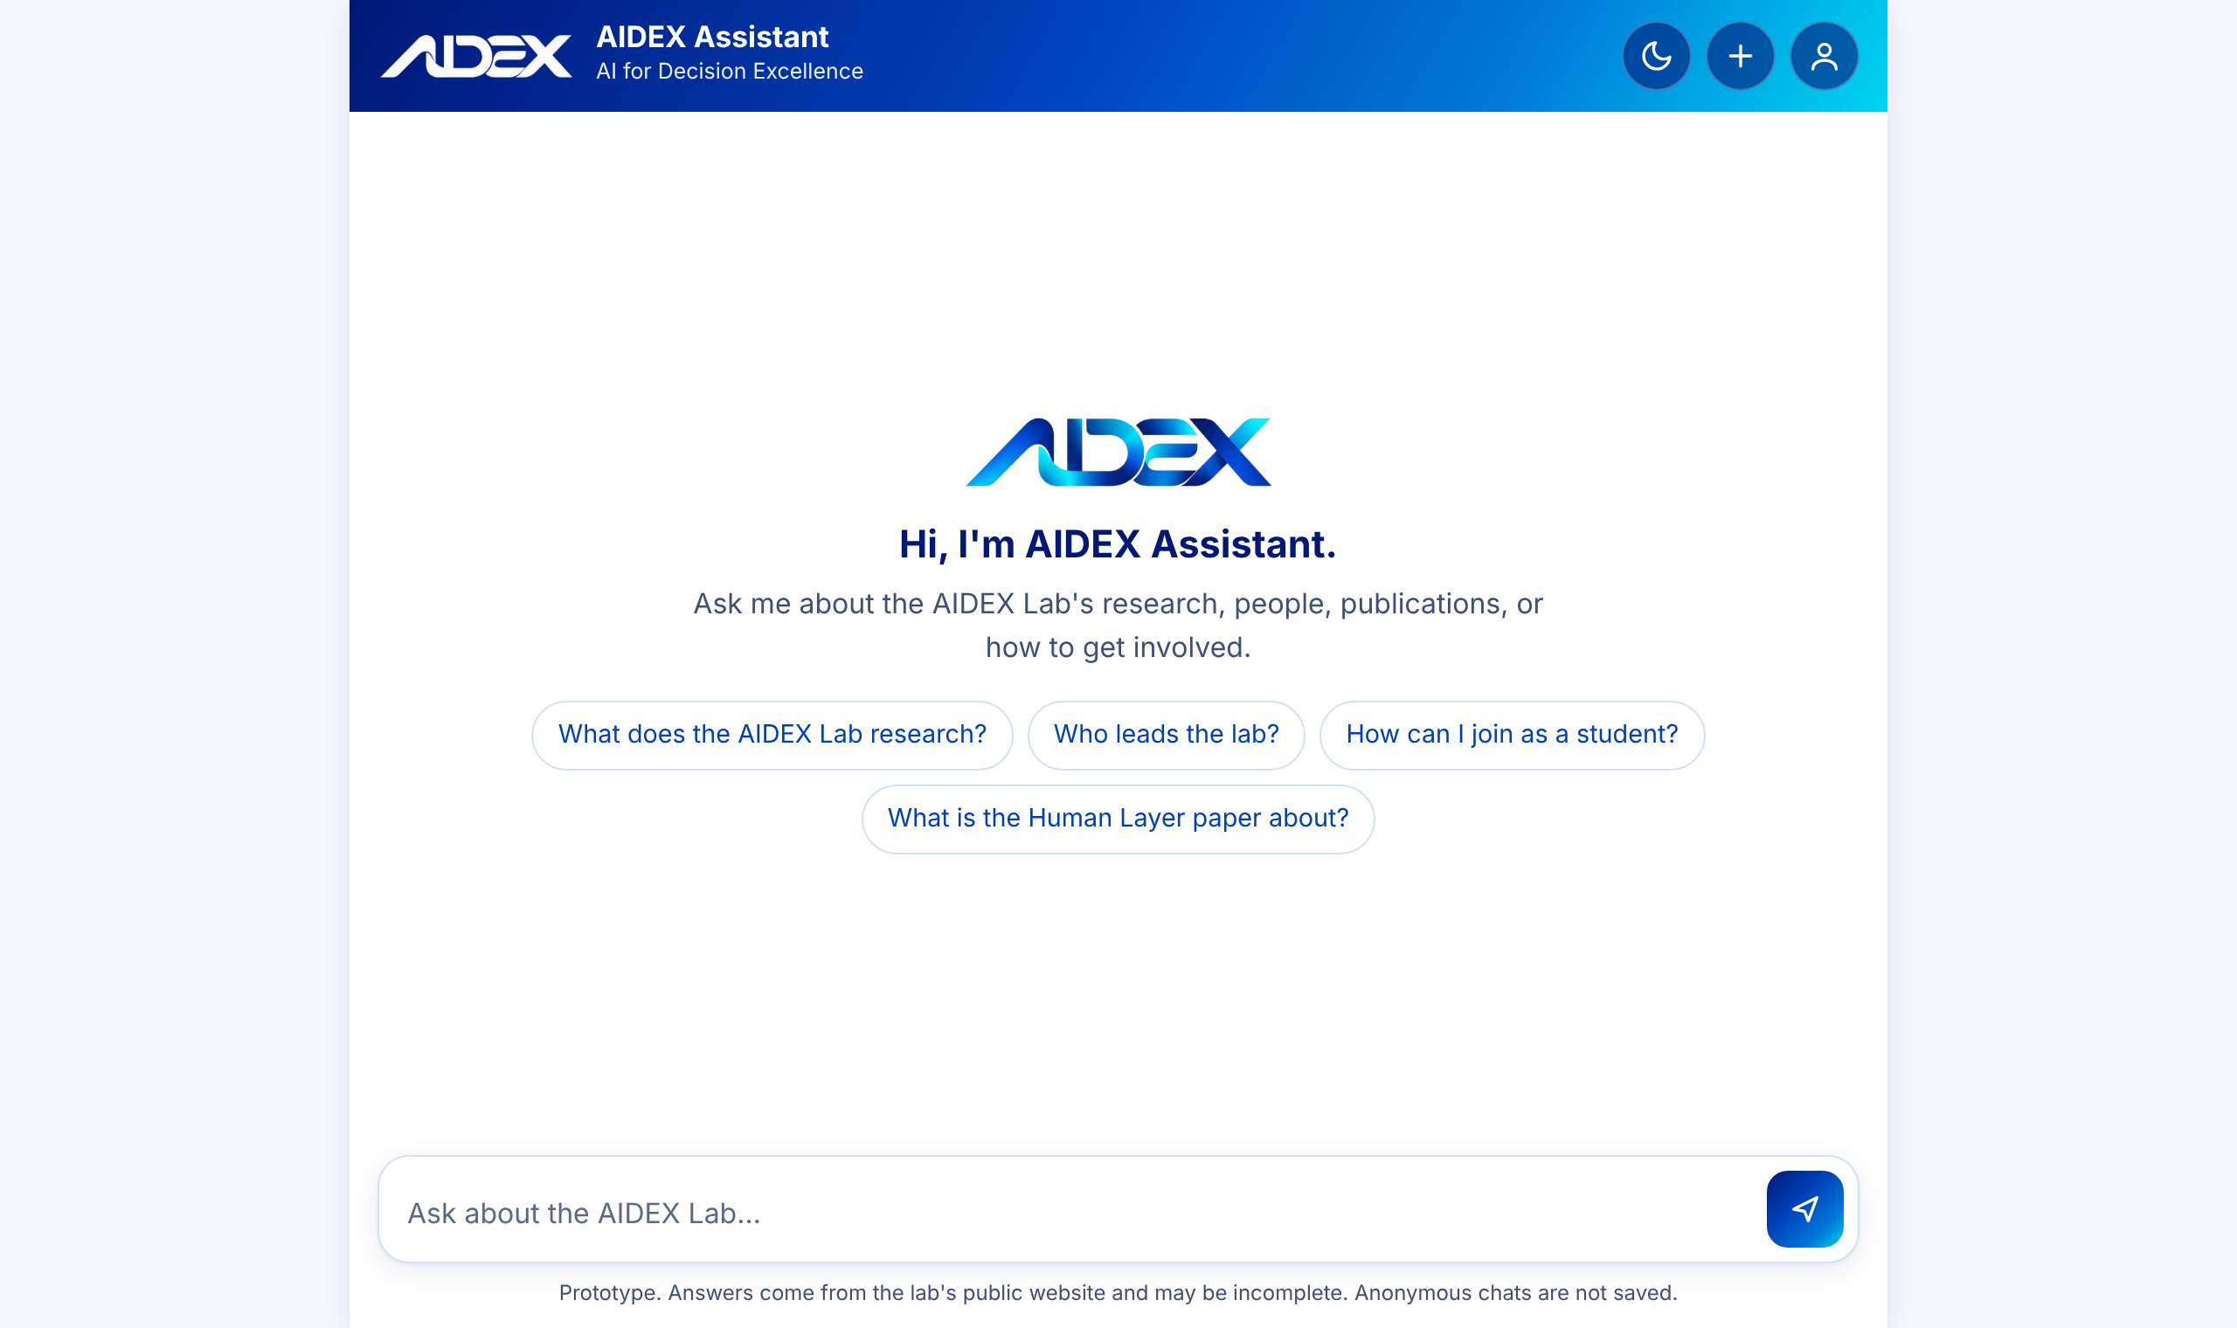
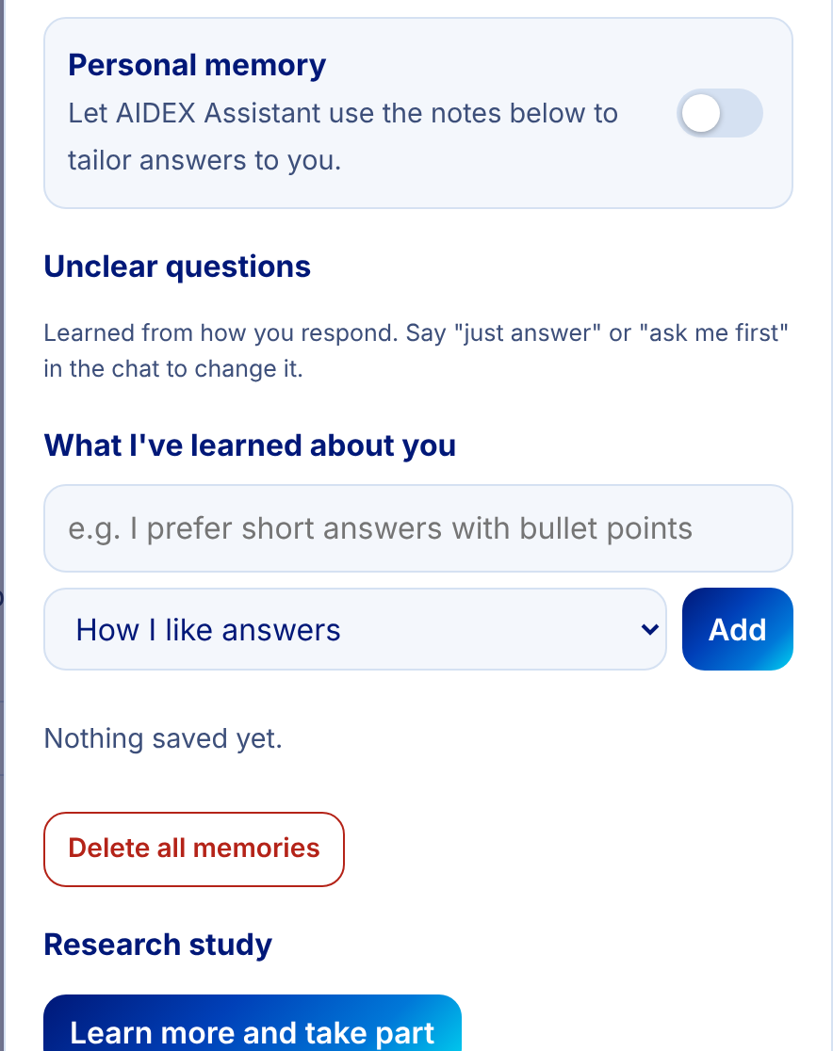
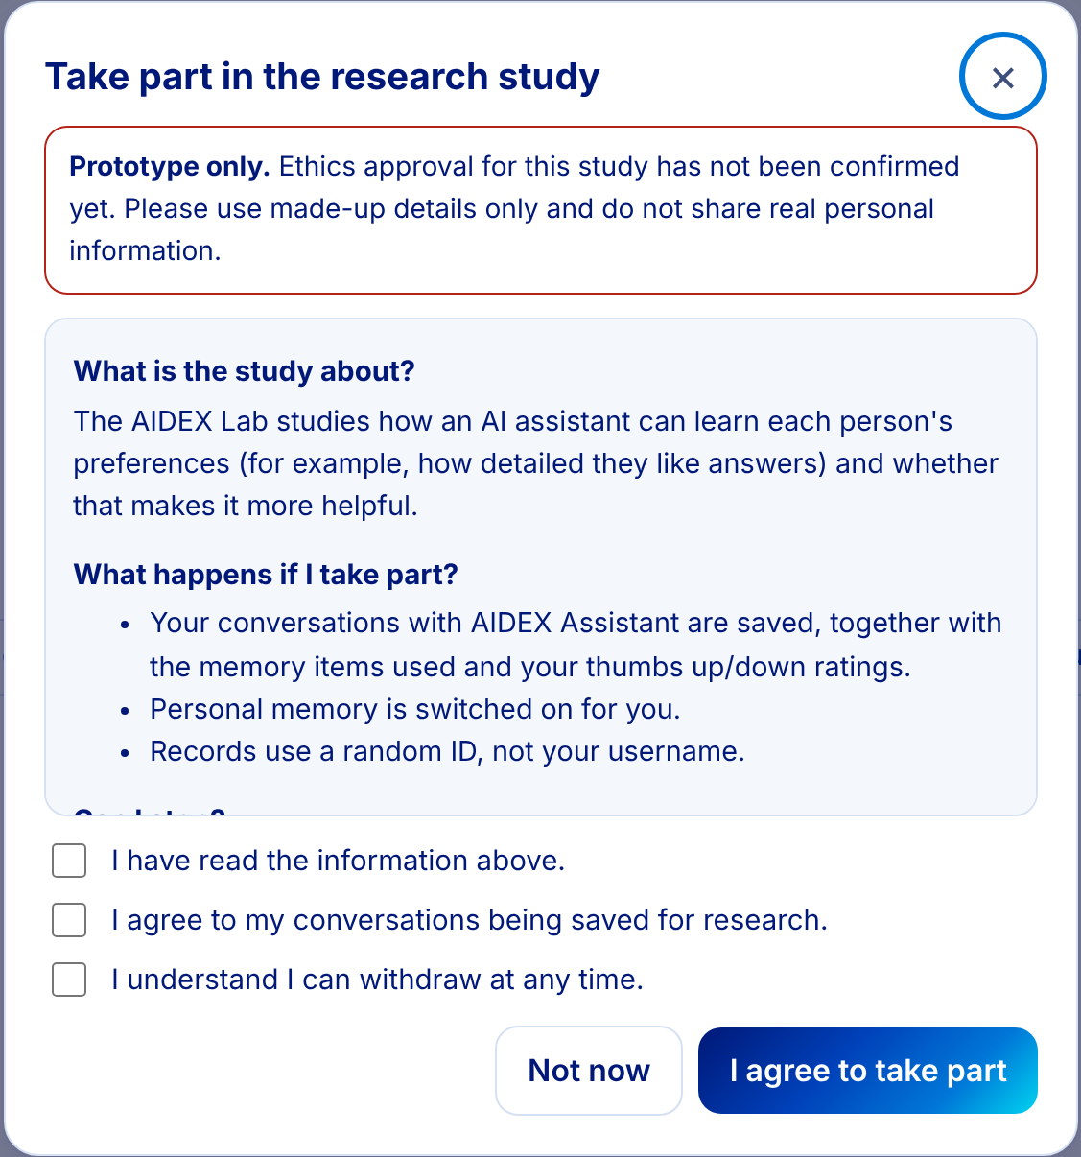




Screens from the working prototype
WHAT HAS BEEN BUILT
Chat with starter questions, light and dark mode, works on phones
Memory the user can see, edit, pause or delete
Research consent, with a clear prototype notice
Opt-in memory
Full control
Informed consent
Download or delete your data
Notes:
Here's what I've built. On the left is the chat assistant. It opens with starter questions, supports light and dark mode with accessible colours, and works on phones. In the middle is the memory panel: memory is off until the user switches it on, and everything it learns is listed, so they can edit, pause or delete it. On the right is the research consent screen. Because ethics approval isn't confirmed yet, it clearly says this is a prototype, and only people who agree have their conversations logged, under a random ID. Users can also download their data or delete their account at any time.

Slide 13



Testing and evaluation
HOW IT WAS TESTED
Three user types
Anonymous visitors, students with memory, and consenting research participants
Automated tests
Unit and API tests cover retrieval, memory, guardrails, privacy and the dashboard
Synthetic users
A simulation runs the full learning loop over several days, so no real data is needed
Notes:
To test it, I wrote 39 evaluation questions that are scored automatically. Most check lab knowledge, and the rest check memory and learning, safety, and privacy and consent. They run as three types of user: anonymous visitors, students with memory switched on, and consenting research participants. There's also an automated test suite, and a simulation of synthetic users that runs the whole learning loop over several days. That's what fills the admin dashboard, which shows the reuse ratio next to the paper's 3.4 to 1. I want to be clear these are synthetic users, so they show the system works, but they're not research results yet.

Slide 14
Where this goes next
NEXT STEPS
Now
Next
Then
Later
Working prototype
Better answers
Real study
On the lab website
Lab knowledge base
Two-layer memory
Dashboard and tests
Larger local model
Paper abstracts and FAQ
Welcome screen
Ethics approval
Real participants
Compare with and without memory
Guided PhD and partner flows
Deploy for visitors
Notes:
For future work: right now it's a working prototype. The next step is better answers: a larger local model, adding the paper abstracts and an FAQ to the knowledge base, and a welcome screen. After that, with ethics approval, the real test is a study with real participants, comparing the assistant with and without memory to see whether preferences really get reused more than facts, as the paper predicts. Longer term, it could go live on the lab website with guided flows for prospective PhD students and industry partners.

Slide 15
Thank you
An assistant that answers from verified lab data, learns how each person likes to be helped, and measures whether that matters more than facts
Questions and feedback welcome
Notes:
To sum up: Priya shouldn't have to repeat herself. The AIDEX Assistant answers from verified lab data, learns how each person likes to be helped, lets them stay in control, and measures whether those preferences really matter more than facts. Thank you for watching. I'd really appreciate your feedback and guidance.

